Slide 1
Python Programming Language
Python Data Structures || RegEx || Loops in Python
Reshma Jayaprakash
Trainee at Scifor Technologies
STB03011

Slide 2
Python Introduction
Python is a popular programming language created by Guido van Rossum. Python has many applications like,
It can be used on a server to create web applications
Python can connect to a database system. It can read and modify files.
It can be used to handle big data and perform complex mathematics

Slide 3
Python Data Structures
Data structure is a way of organizing data in computer memory
Built-in data structures in Python can be classified as Mutable and Immutable
Three mutable data structures are lists, dictionaries and sets
Immutable data structure in python is tuple

Slide 4
Python Data Structures
Python Lists
Dynamic mutable arrays
Ordered collection of items
Python lists can contain all data types
List Functions
sort() – Sorts the list in ascending order
type(list) – It returns the class type of an object
append() – Adds a single element to a list
extend() – Adds multiple elements to a list
index() – Returns the first appearance of the specified value

Slide 5
List Functions Contd..
max(list) – Returns an item from the list with max value
min(list) - Returns an item from the list with min value
len(list) – It gives the total length of the list
cmp(list1, list2) – compare elements of both lists, list1 and list2
reverse() – Reverse the elements of the list
count(x) – Return the number of times x appears in the list
pop([i]) – Remove the item at the given position in the list, and return it. If no index specified removes and returns the last item in the list
clear() – Remove all items from the list

Slide 6
Python Data Structures
Python Tuples
Tuples are immutable
A data structure once created cannot be modified
Tuple contains ordered collection of items
To create a tuple, we can use round brackets () or the tuple() constructor

Slide 7
Python Data Structures
Python Sets
Sets in Python can be defined as mutable dynamic collections of unique elements
Collection of unordered items
To create a set, we can use curly brackets { } or the set() constructor
Set Operations
union() – Returns new set containing the union of two or more sets
intersection() – Returns a new set which is the intersection of two or more sets

Slide 8
Set Operations Contd..
difference() – Returns a new set containing the difference between two or more sets

Slide 9
Python Data Structures
Python Dictionaries
Mutable Data Structure
Dictionary contain a collection of keys associated with corresponding values
We can create a dictionary with curly brackets { } or the dict() constructor

Slide 10
Python RegEx
A regular expression, RegEx is a set of characters that helps to find a certain pattern.
Regular expressions are patterns or a sequence of special characters that help programmers to find or match patterns present in the text.
RegEx Module
Python has a built-in package called re
Import the re module

Slide 11
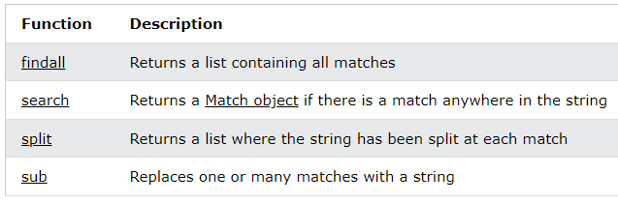
RegEx Functions
re module offers a set of functions that allows us to search a string for a match:

Slide 12
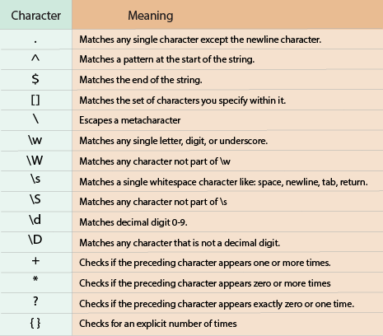

Slide 13
Use cases of RegEx
Verify the structure of strings
Extract substrings from structured strings
Search / replace / rearrange parts of the string
Split a string
Pattern Validation in Forms
Data Extraction, etc.

Slide 14
Loops in Python
While Loop
A while loop is used to execute a block of statements repeatedly until a given condition is satisfied
Syntax:
while expression:
statement(s)
Syntax of While Loop with else statement:
while condition:
# execute these statements
else:
# execute these statements

Slide 15
Loops in Python
For Loop
A for loop is used for iterating over a sequence (that is either a list, a tuple, a dictionary, a set, or a string)
Syntax:
for val in sequence:
# statement(s)
Here, val accesses each item of sequence on each iteration. The loop continues until we reach the last item in the sequence.

Slide 16
Examples
https://github.com/ReshmaJP/Scifor-Technologies-Training/blob/main/ppt_examples.ipynb

Slide 17
Thank You

